Slide 1
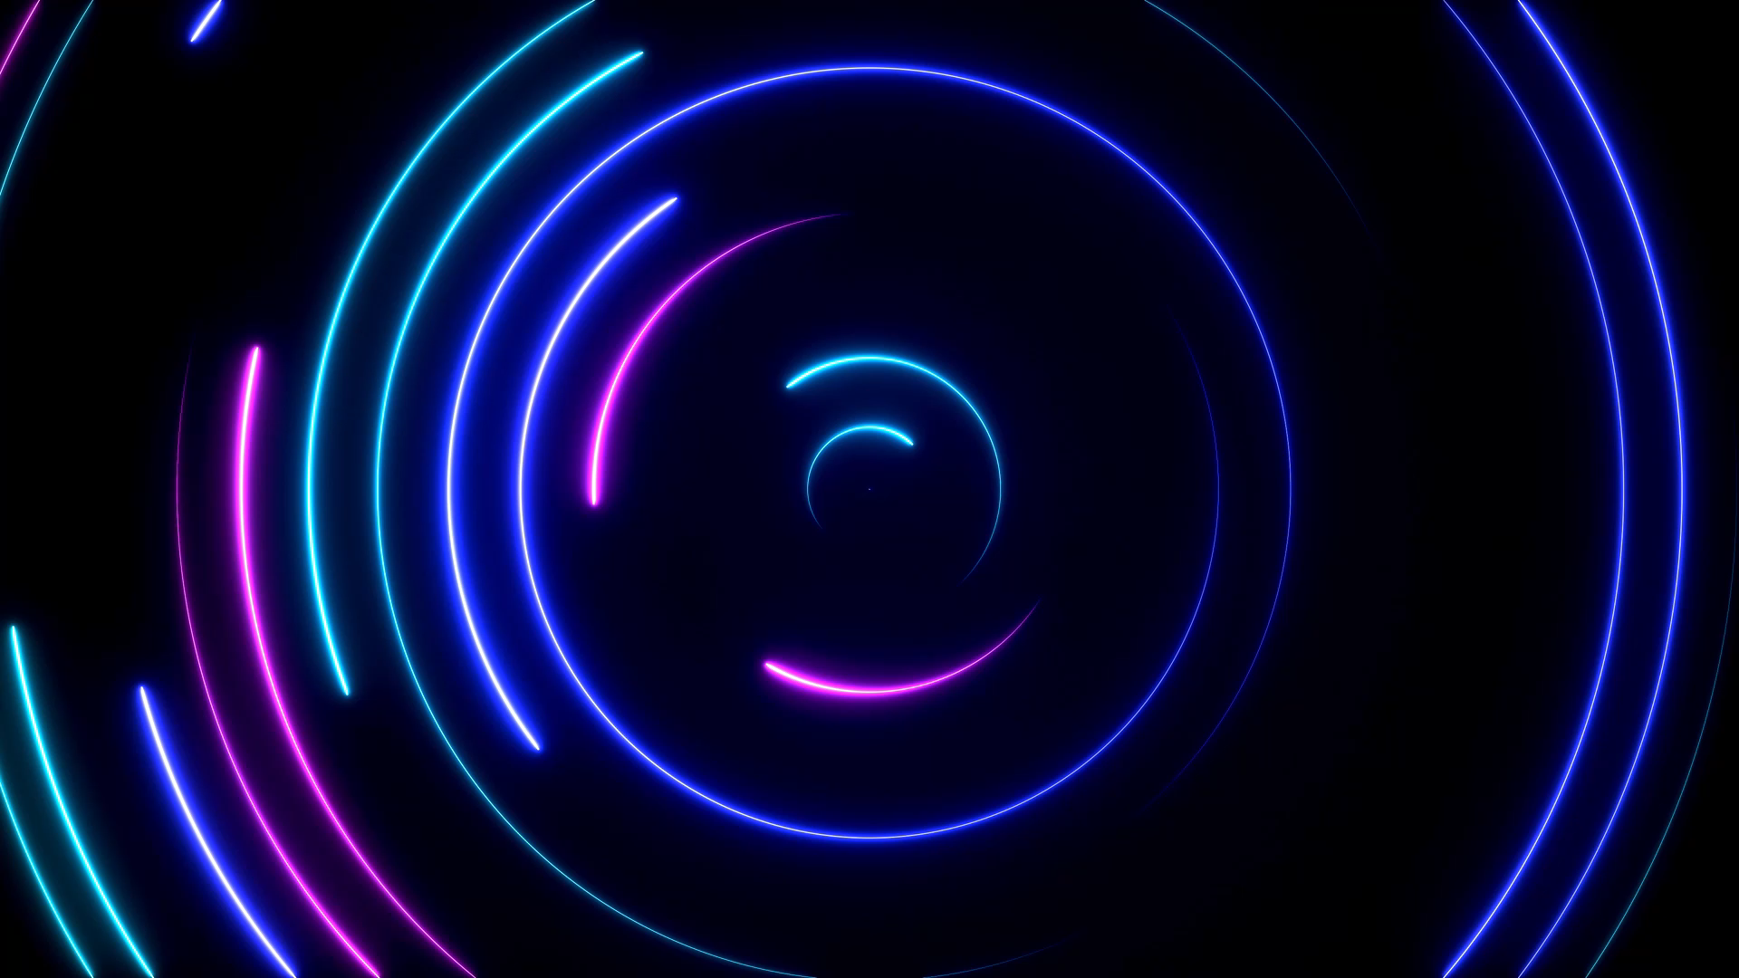
Sound Reactive LED Strip with Audio Sensor.
PRESENTATION
By
Group 8

Slide 2
Group members
1. FAHIMA ISLAM
2. S M SARAR SAKIB
3. MD. FAZLEH RABBI YAHIA PRANTO
4. TOUHIDUL ISLAM MASFI
5. SOUMEN DAS

Slide 3
Contents:
Introduction
Objective
Theory and Methodology
Materials
Hardware Setup
Programming
Testing
Results
Applications
Discussions
Conclusion

Slide 4

Introduction:
Sound-reactive LED systems synchronize visual effects with audio, enriching experiences in entertainment, art, and ambient settings.
Our project integrates an audio sensor with an LED strip, aiming to automate fan control and provide hands-on learning of electronic components.
The report discusses theory, methodology, and outcomes, showcasing the system's potential applications in diverse environments.

Slide 5
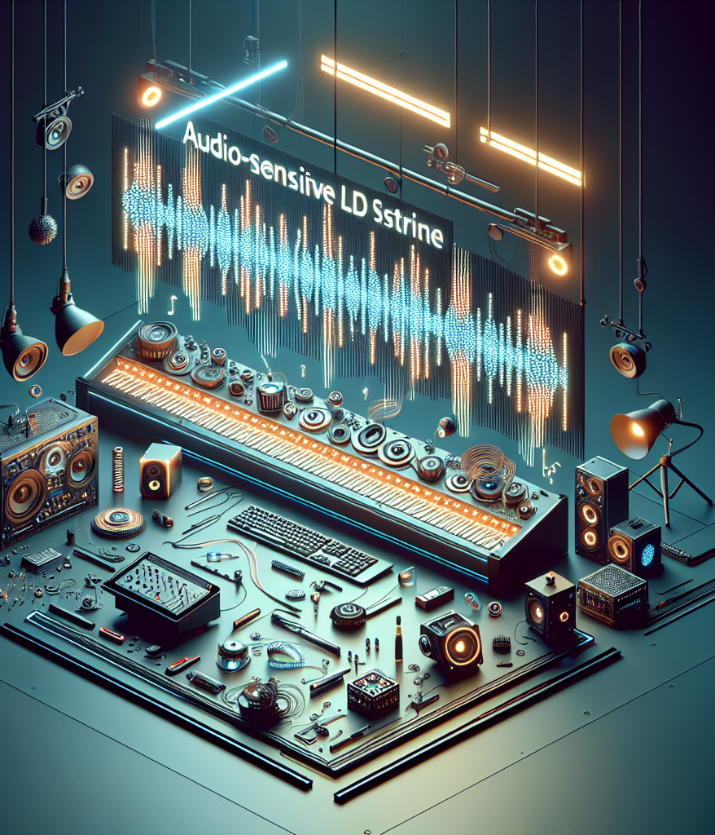
Objective
Providing a practical understanding of electronic components: sensors, Arduino microcontroller, RGB LED strip, and jumper wires.

Slide 6
Theory and Methodology
Sound-reactive LED lighting systems synchronize visual effects with audio input, enhancing user experiences.
Aim: Developing a sound-reactive LED strip system integrated with an audio sensor.
Methodology: Hardware setup, programming, and testing for responsiveness to different audio inputs.

Slide 7
Materials
Computer with Arduino IDE for coding.
RGB LED Strip (1)
Mosfet (1)
Resistors (1 each)
Power Supply (1)
Arduino (1)
Project Board (1)
Sensor (1)
Jumper Wires (12)

Slide 8
Hardware Setup
Connect RGB LED strip and audio sensor to the Arduino microcontroller.
Wiring involves digital output pins for the LED strip and power/analog pins for the sensor.

Slide 9
Programming
Write Arduino code to read sound input from the sensor and control LED strip brightness and color.
Utilize libraries like Fast LED for LED control and color manipulation.
Implement algorithms for smooth transitions and visually appealing effects.

Slide 10
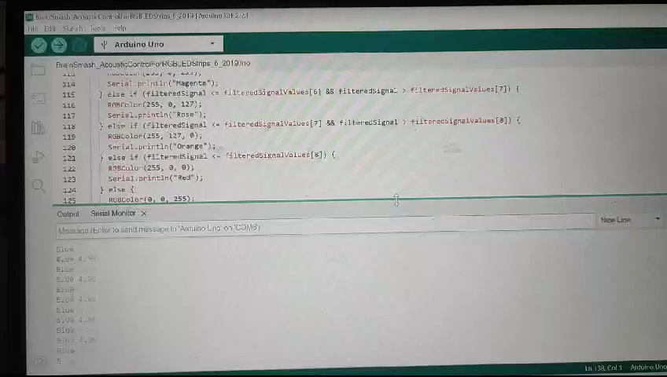

Testing
Evaluate system responsiveness with various audio inputs: music, speech, ambient noise.
Monitor LED behavior in real-time and adjust code for improved performance.

Slide 11
Results
The sound-reactive LED strip effectively responds to sound input, creating visually dynamic effects.
Higher sound levels result in brighter, intense LED colors; lower levels correspond to dimmer, subtler effects.
Responsive to different audio inputs, including music beats, voice commands, and environmental noise.

Slide 12
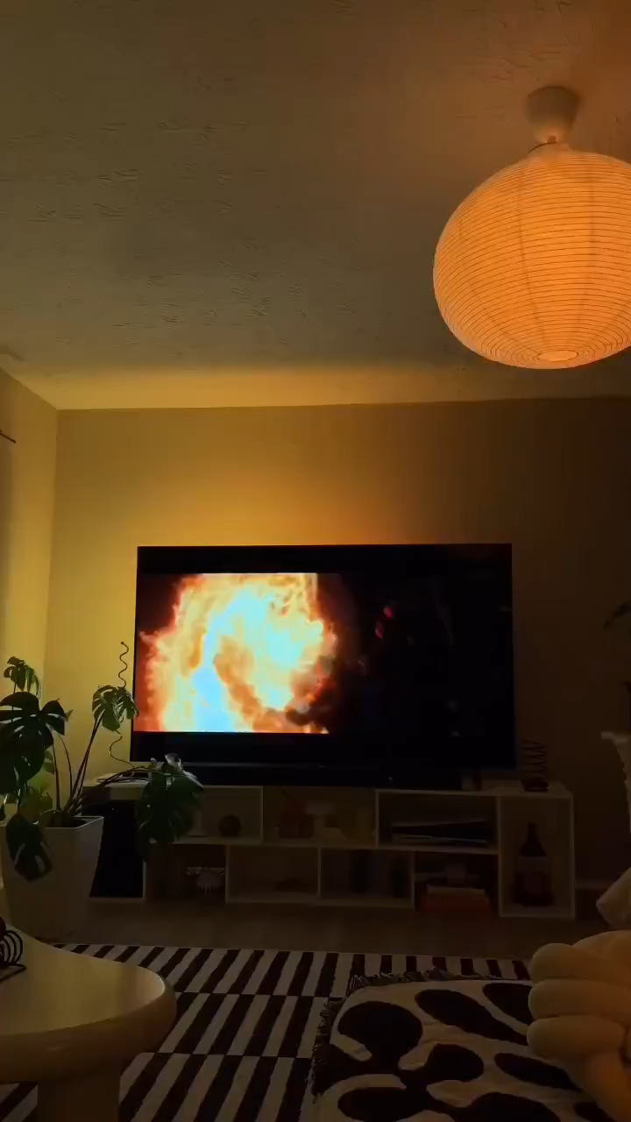
Applications
Interactive installations: art exhibits, performance stages, interactive displays.
Live performances: synchronized lighting effects with music or spoken word.
Ambient lighting: dynamic environments in homes, clubs, restaurants, or events

Slide 13
Discussion:
Integration Potential: The successful implementation of the sound-reactive LED strip system underscores the potential of integrating audio sensors with LED technology.
Versatility: Such systems offer versatility in applications, including interactive installations, live performances, and ambient lighting in various settings.
Considerations: Factors such as sensor range, sensitivity, and programming complexity are crucial considerations for optimizing system performance.

Slide 14
Conclusion:
Feasibility: The project demonstrates the feasibility of integrating audio input with LED technology, offering creative possibilities for interactive lighting systems.
Achievements: Through hardware implementation, microcontroller programming, and real-time testing, the system achieved its objectives effectively.
Innovation: This project contributes to the advancement of interactive lighting technologies, opening avenues for creative expression and innovation.

Slide 15
THANK YOU

